Slide 1
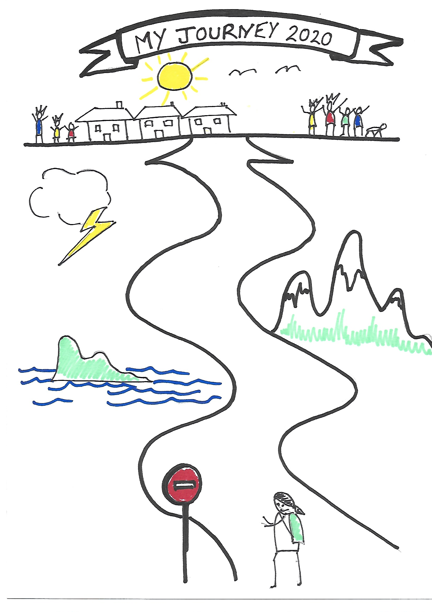
Life Journey Work By Jo Salmon & Emma Cobb November 2021
By Jo Salmon & Emma Cobb
November 2021

Slide 2
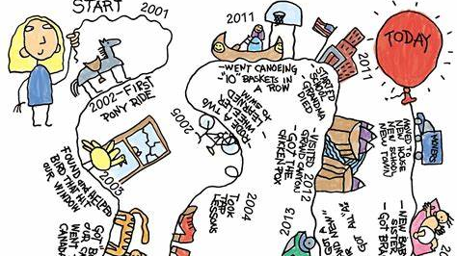
Welcome
Housekeeping
Evaluation & Certificates
Introductions
Notes:
Housekeeping:
Coffee break
Introductions:
Name
Role
How long in the team
One word that sums up how you feel about LJW

Slide 3
Aims & Objectives
What?
Why?
When?
Who?
How?
Have a go!
Barriers
Examples
Resources
Notes:
What are you hoping to get out of today? Ask them if they have specific questions or needs – flipchart.

Slide 4
Let’s Get Started..
Notes:
Lets get started:
2 exercises:
Do you know questionnaire:
Do you know why your parents chose your name?
What did you look like as a baby?
How many siblings do you have?
How old were you when you started walking?
Could you find out what the weather was on the day you were born? – who from?
What was your first ever holiday? – if you don’t know could you find out?
Who was your first friend?
What are you grandparents’ names?
How was your birthday celebrated when you were little? Did you have any parties?
What primary school did you go to?
Imagine:
Close your eyes…
Imagine you’re 8 years old
Your mum tells you you’re going to move to live somewhere else in anywhere town. She’s packed your suitcase ready
What will you miss? It might be things like:
The creak of your stairs when you run up and down
The light on the landing outside your bedroom that you can see through the crack in the door at night
The old apple tree at the bottom of the garden
Your best friend who lives next door
Going to the park down the road on Saturdays
Watching the fireworks on November 5th from your mum’s bedroom window
Toasting marshmallows on the firepit

Slide 5
What and Why?
CA 1989: ‘Life Story work with each child and young person is essential if they are to understand what has happened in their childhood. This should include photos and other significant memorabilia. A copy of the whole life story work record should be kept securely’
A way of helping children & young people in care begin to understand and accept their personal history and to develop an integrated sense of him or herself
For children growing up away from birth parents, their histories are often fragmented and difficult, full of separation and loss. Life story work is a way of recording and treasuring these stories and helping children to understand them
For every child and young person to:
Develop a realistic understanding of the background and history of their birth family which dispels fears and fantasies
Know where they came from and develop a sense of identity including their religious & cultural heritage and ethnicity
Understand why they are separated from their birth family, know who has cared for them and put their past into perspective, and to acknowledge issues of separation and loss
Build positive self-esteem and a sense of positive self-worth
Develop a sense of security and permanence and to promote attachments
Feel confident to share their past with others
Share their wishes and feelings – what’s important to them - and understand and articulate their feelings
Ofsted praise council for life story work: Life-story work was highlighted as an area of “exceptional practice” by inspectors at Telford and Wrekin council. “It is not seen as a ‘one off’ piece of work, but is continually revisited throughout a child’s life and at key developmental stages.” (2020)
Notes:
(CA 1989 – 4.29 Pathway Planning)
Most of us lucky enough to know about our own history, we can take it for granted or at least have access to a family member or friend who might know the answer.
For children who grow up away from their birth parents, this is not always the case. Their files may be incomplete, inaccessible or inaccurate; they’re unlikely to include many of the intimate personal details that give us a sense of who we are and where we come from.
Children may be reluctant to ask the adults around them questions for fear of upsetting them or making them angry. For some, these adults maybe virtual strangers who have little knowledge of the child’s story and not enough time to find out.
For many children in the care system, the stories that they need to understand are complex and painful: stories of violence, loss, illness, death, drugs and sexual abuse. Subjects that many adults find hard to discuss and are fearful of tackling. But these children need answers, they need stories, they need the adults around them to be brave enough to try to explain.
Children also need the adults around them to have had training and support in tackling these difficult issues. They need them to have time to think and to read the files and to have the confidence to broach the subject.
They need the adults who care for them or work with them to stick around for long enough to really get to know them, to understand the best way to communicate and to build up trust.
Children need adults who understand that knowing where you come from is part of knowing who you are.
These adults – social workers, foster carers, adopters, family support workers, kinship carers – need to know that they have the support of an organisation that values spending time with children and will support them in working out what to say and how to say it.
Life journey work is not a probing of what the child already knows, remembers, and/or is willing to share; rather it is a way of helping the child to link his/her past with his/her present and his/her future.
Assuming an appropriate age and understanding, the child will already have some information and feelings from having had the experiences that he/she has had.
Life Journey Work is a process aimed at enabling the child to gain and assimilate further information that builds on his/her previous memories and understanding, and to share and confirm his/her memories and understanding on the basis of this new information, with a trusted adult who is able to, where necessary, provide support aimed at helping the child to heal.
What can we do? –
Things we can do every time we visit a child.
Remember that as SW’s we’re there to answer questions as well as to ask them, and that we hold children’s stories in our heads and in our files. We can do our best to keep these stories safe, to record them well and to have the courage to speak about them with the children who lived them.
We can be honest when we don’t know the answers and keep our promise to try and find out.
We can speak of birth families with respect and compassion without denying the hurt the child has suffered.
We can be open when professionals have got it wrong and apologise.
We can have a go at explaining even though we’re scared of getting it wrong – and try again when we do.
We can remember that playing and talking is real social work, the heart of our practice, not a luxury and value our toys, pens and games as the tools of our trade.
We can’t always mend what is broken in children’s lives, take away pain or find the family they need. But we can do our best to grasp what it is like to be that child and to share the information that they need to make sense of their life and who they are.

Slide 6
Without it….
Children can feel confused and despondent. They can label themselves as ‘unlovable’ or blame themselves for their family’s disruption
This is likely to impact on their emotional well- being and mental health and can affect school, peer relationships etc
Children will fantasise and put themselves at risk by returning ‘home’ – but don’t have full facts and internalise and blame/ shame
As adults they can access their files and will have had no sense of preparation on reading potentially distressing information
‘I knew difficult decisions were made about me, that I couldn’t live with my family but I don’t know why - nobody ever told me.’

Slide 7
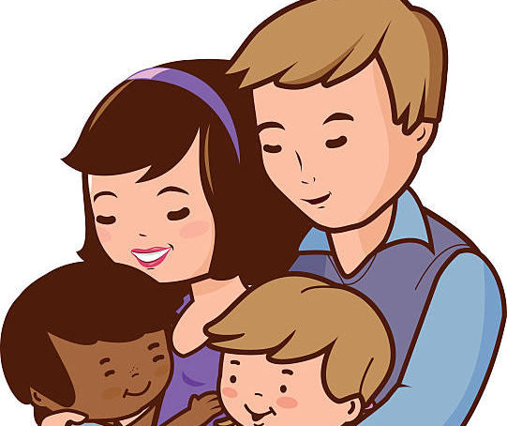
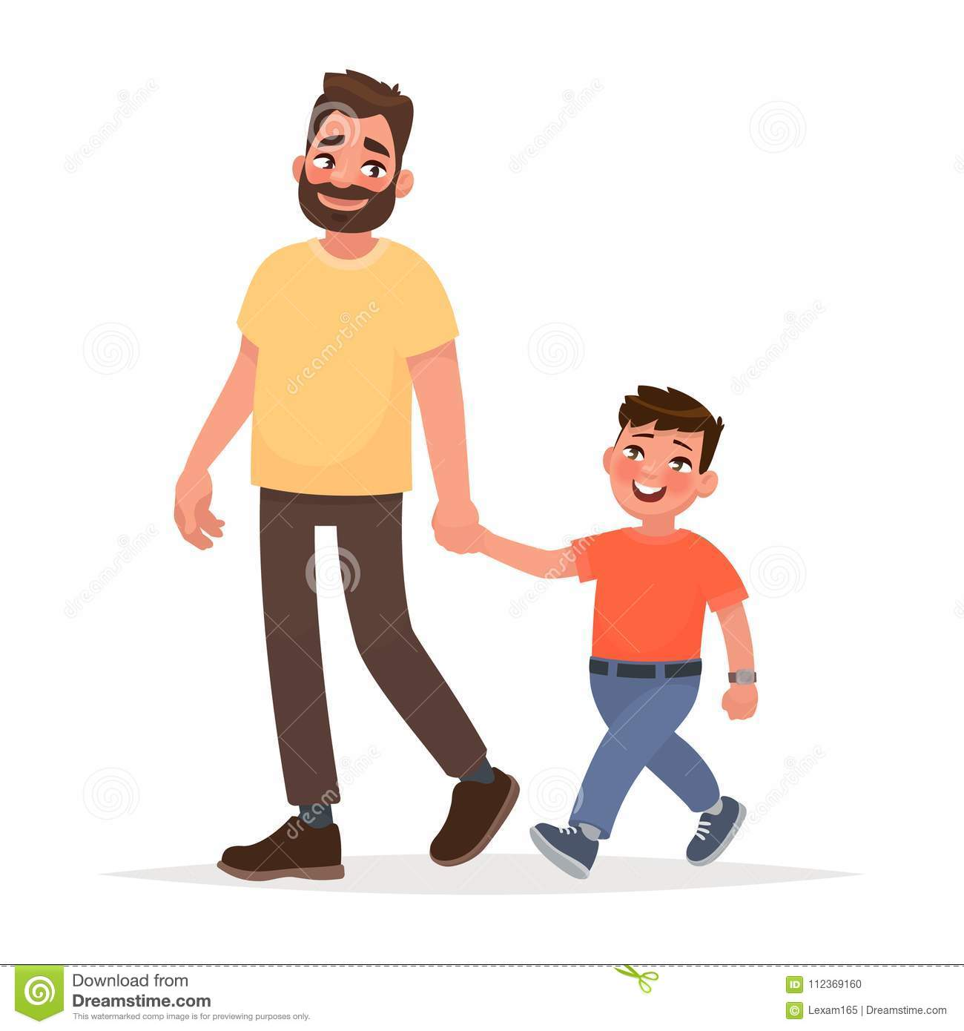
Who?
You ☺
Foster Carers
Residential Keyworkers
Supervising Social Workers
IRO’s
Children’s Advocate/ Independent Visitors
Birth Parents/ Extended Family/ Siblings
Practice Assistants/ Family Workers/ Contact Workers
Other professionals: school staff, therapists
Notes:
You ☺ - SWs responsible for ensuring LJW is being completed and is ongoing. The process may involve others as below – a clear plan should be agreed by everyone relevant so there’s no confusion.
Foster Carers
Residential Keyworkers
Supervising Social Workers
IRO’s
Children’s Advocate/ Independent Visitors
Birth Parents/ Extended Family/ Siblings
Practice Assistants/ Family Workers/ Contact Workers
Any professional worker or carer undertaking direct work with a child should have a sound knowledge of child development and at least a basic understanding of attachment theory. The appropriate time for life work to be undertaken and the most appropriate format for the work, will vary from child to child, and will generally depend on the child’s emotional and cognitive stage of development and his/her individual life experiences and care arrangements rather than exclusively on his/her chronological age.
COFFEE BREAK

Slide 9
What’s Good Practice?
Notes:
Share in groups and then with the wider group – their examples of things they’ve done.

Slide 10
When and How?
You Tube clip
Age-appropriate
Plan and Planning
Order
Practicalities
Ground Rules
The Finished Product
Notes:
WHEN:
Informal life journey work should be continuous, live and meaningful - part of the social worker’s regular statutory visits.
More specific LJW – decision made around this during placement planning, reviews as part of their care plan – should be based on child’s needs, views and assessment of their carers’ likely ability to support them.
Life journey work can start wherever the child wants to begin; this may be with his/her present situation or may be at a point in his/her past. It can be helpful to in the early stages draw up a preliminary list with the child of what might be covered, including names of people, places, and events. This means that the work does not necessarily have to be completed in a chronological order; it can be topic based to suit the child and is likely to enable him/her to feel more comfortable with sharing and exploring experiences and/or new information.
Usually be important for the child to know in advance when and where sessions will take place and who will be involved in them.
For older children: it may be important to agree the number of sessions anticipated when the work starts and to then review this agreement as the sessions progress. It is usually helpful if at the end of each session the child is made aware of what the plan is for the next session; if the child expresses concern the plan should be changed as required in order to encourage the child’s full participation.
It must be remembered that life journey work should largely be led by the child so the direction that the work takes may need to change as the work progresses and earlier plans may need to be modified or abandoned.
Life journey work should be enjoyable and engrossing; however, there may be times when the content brings up intense feelings for the child.
Important for both the child and the professionals and for any birth family members or carers involved in life journey work, to have support in place for them while the work is underway.
For children this will usually be provided by their carer(s) or key worker(s).
For professionals and carers some kind of regular support/consultation/supervision can be helpful to maintain the focus of the work on the child.
Where a child’s birth family members are involved in the completion of the work consideration should be given in advance to who can most appropriately provide their support.
HOW:
Things to think about:
The Inside Story – asking those who know the child the best – their normal presentation, how they react if they’re struggling, anything other pointers
Venue and space – you do not need a lot of space however the child that you are working with needs to feel comfortable and have a sense of privacy
Time – you need to allow enough time to complete the exercise and to deal with any issues that may emerge. A child may complete the exercise very quickly and may not seem to want to discuss anything in detail. Let their parent/carer or teacher know that they have completed the exercise in case issues arise at a later point
Resources - make sure that you have a pack of resources available including paper, pens, copies of worksheets, arts and craft materials and small toys etc. Involve the child in choosing how their LJW/book or other visual record will look
Comfort - think about drink, food, toilets and anything else a child might need to keep them feeling relaxed and safe. Interruptions such as telephones or people coming in and out, or loud noises that make it hard to concentrate should be avoided
Clear brief - ensure that the child and any other people participating in the activity understand the process, what they will be expected to think and communicate about, and for what purpose the information will be used
Confidentiality - It is important that the child is aware of any issues of confidentiality. Things to consider include what happens to any information that is shared in the course of the exercise? Is it discussed outside the room? If so by whom and for what reason? It is important that the child is aware of this, although this should already be understood
Ownership – It is important to talk about what will happen with the sheets/paper at the end of the activity; if this is clear from the start for everyone involved, as well as the child, you can just do a reminder at the start and end of each session as needed
Ground Rules – Social Worker’s Toolkit ‘Making History’ (pages 2&3):
Be prepared
Choose a private and comfortable setting
Brothers & Sisters
Build Trust
Explain your role
Have frequent sessions
Involve the child
Encourage parental support

Slide 11
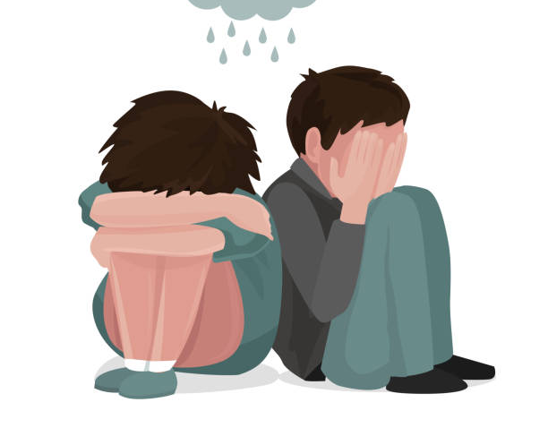
If it’s not the right time for the child…
Clear plan, to be kept under review:
Formal record - reviews
If the Child/Young Person is:
Refuses
Reluctant or Resistant
Disengaged
Over-excited
Sad
When they’re receiving therapy
How to manage this:
Contingency Planning
Don’t just stop…
Notes:
Plan to be kept under review – if deemed not to be appropriate at any time this should be discussed within formal reviews and reasons noted to ensure a clear record.
If a child is clearly disengaged or reluctant to engage in life journey work then this should be respected – it’s to be expected that this may be the case given the complexity of their journeys, experiences and the trauma involved. It could be that the child is finding it too difficult to contemplate or that there are events happening around him/her which undermine his/her capacity to undertake the work. A session should ideally still take place, involving an activity and discussion that will enable the worker to convey his/her acceptance of the child’s feelings, and a genuine interest in his/her wellbeing. The worker and the child should agree the activity to be shared.
Complete work behind the scenes so there is a clear record on file when a Young Person reaches 18 – you can always share it with them before then if they change their mind.

Slide 12
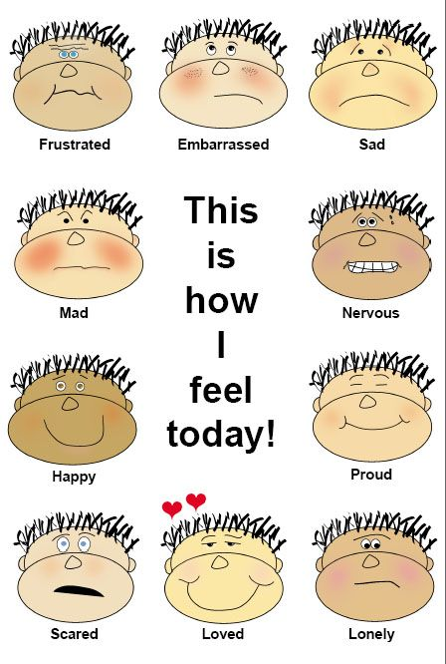
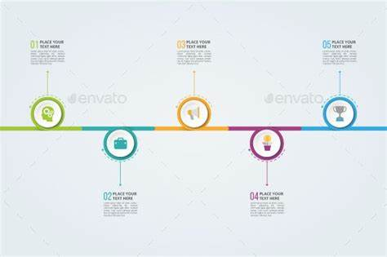
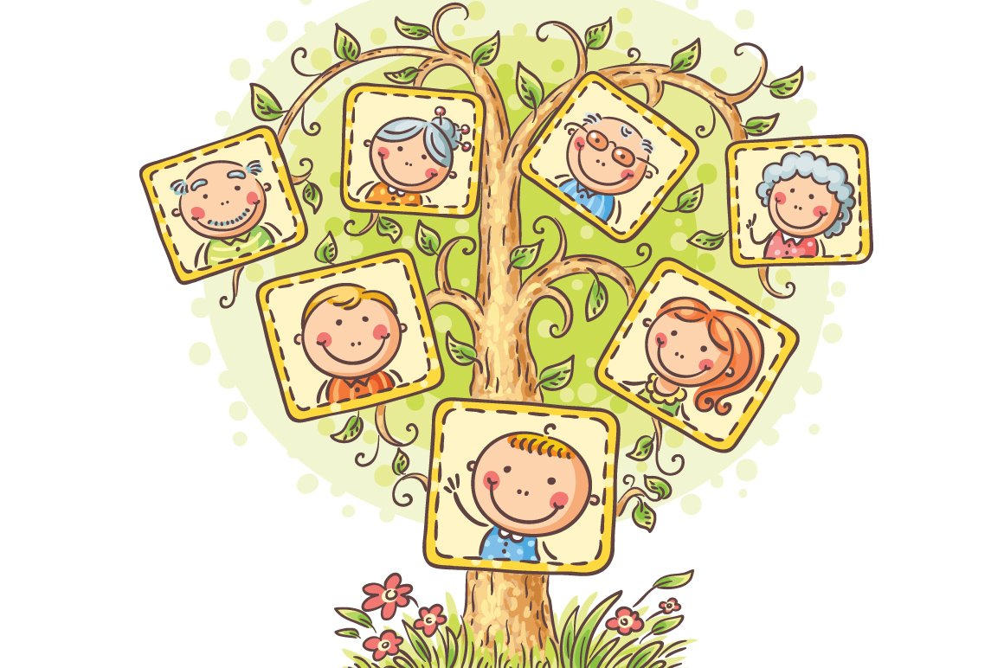
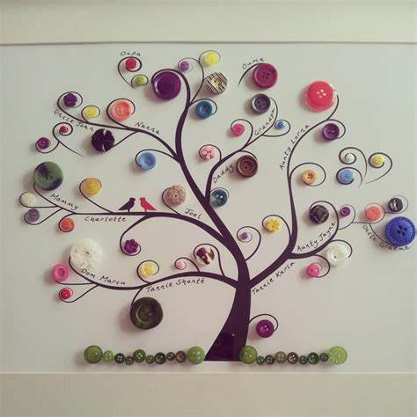
Resources
Notes:
Resources/style:
Think about the finished product – what is most appropriate given the age, stage, need, situation, understanding; what would the child/young person like?
Genogram/family tree – drawing, photos, pictures, buttons, Lego, figures, animals
Ecomap – ‘who supported/supports me’
Identity poster
Timeline - with photos
Questions jar
Scrap book
Photo Album
Journey/maps
Later Life Letters – for all, importance, go through ahead of 18th birthday if possible
Memory boxes – foster carers
Supporting children to express emotions; capturing this – emotions/teddy bear cards

Slide 13
Overcoming Barriers
What are the barriers?
How can we overcome them?
Notes:
In pairs then feedback to the group.
What are the barriers?
Time?
Lack of confidence?
No clear plan?
Worry about re-traumatising children?
Lack of resources?
How can we overcome them?
Gathering resources at the Here4U house – ready to use
Looking at examples and templates – see social workers toolbox link on last slide, good examples could be collated by the team?
Plan and planning – making use of other professionals to make shared decisions, using their knowledge and experience of the child/young person
Ensure we involve the team around each child/young person – we don’t have to do it all
Ensure support in place – for the child, carers, within the professional team

Slide 14
Case Studies
In groups
3 scenarios:
What life journey work could we undertake and what tools could we use?
What are the barriers and what could we do to overcome these?
Come back together to share plans
What will you take forwards?
Be specific, relate ideas to at least one of your young people

Slide 15
Links
Making History-A Social Workers Guide to Life Books.pdf (ky.gov)
Life story book templates & examples - Free Social Work Tools and Resources: SocialWorkersToolbox.com
Direct work with children (ccinform.co.uk)
Cafcass resources for professionals
Tips for undertaking life story work (communitycare.co.uk)
'Children deserve the best life story work we can give them' - Community Care
Life-story work: Trudy and Keith Pye break the mould - Community Care

Slide 16
Thanks for joining us ☺

